Slide 1

​PIONEERING PUROLATOR CLOUD MIGRATION FOR FINANCIAL EXCELLENCE

Slide 2
Overview
Cloud Migration for Financial Excellence
Why We Choose Public Cloud
Benefits of Public Cloud
Potential Concerns & Solutions
Other Alternatives
Recommendations

Slide 3
Cloud Migration for Financial Excellence
Purolator IT Infrastructure’s Background
Purolator’s Needs

Slide 4
Why Public Cloud?
Cost Reduction
Enhance Operational Efficiency

Slide 5
Benefits of Public Cloud
Expense
Scalability
Accessibility

Slide 6
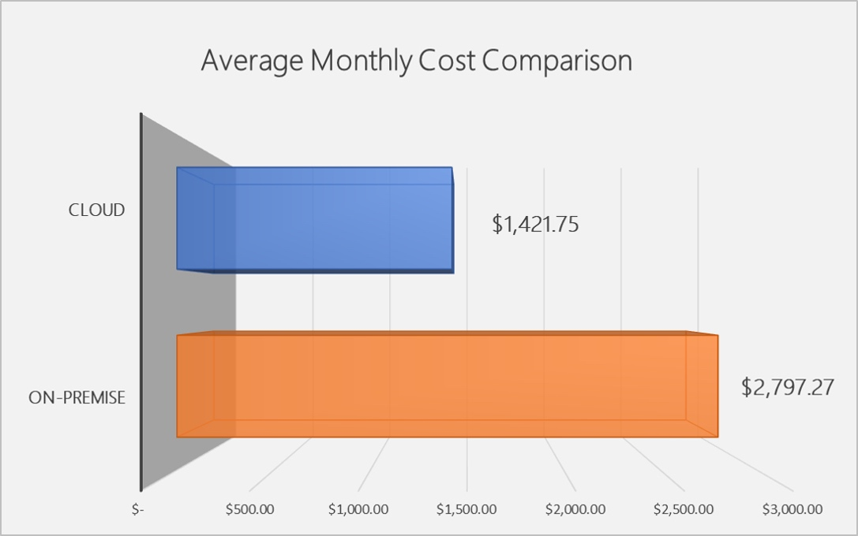
Benefits of Public Cloud
Expense
$1,421.75 vs $2,797.27
~ 50% monthly cost

Slide 7
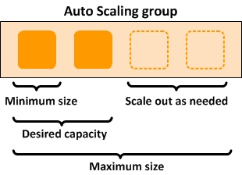
Benefits of Public Cloud (continue)
Scalability
Scale Up
1 month vs 6 months
Scale Down
1 day vs 30 days

Slide 8

Benefits of Public Cloud (continue)
Accessibility
Everywhere, every time
vs
Book appointments, paperwork process, etc.

Slide 9
Potential Concerns & Solutions
Compliance
Data Security
Integration Complexities

Slide 10
Other Alternatives
Hybrid Cloud
Private Cloud

Slide 11
Recommendations
Comprehensive Assessment
Action for Data Security
Gradual Migration
Training and Changing Management

Slide 12
Thank You For Listening
CCBC 7 – Henry & Nam

